Slide 1
IBM Data Science Capstone Project The Battle of Neighbourhoods: Analysing Business Opportunities in Sandakan
Presented by Dennis Lam (Nov 2020)

Slide 2
Agenda
Business Problem
Data
Methodology
Results
Discussion
Recommendations
Conclusion

Slide 3
Business Problem
Business startup owners want to find suitable location in neighbourhoods area
Project objective is to analyze and recommend suitable areas

Slide 4
Data
List of neighbourhoods in Sandakan
Latitude and Longitude of each location
Venues data
Sources of data
Sandakan Municipal Council website
Geopy Python for location coordinates
Venues data using FourSquare API

Slide 5
Methodology
Gather all sources of data
Create a csv file
Create pandas dataframe and do data exploration
Focus and map locations
Use Foursquare API for venue data
Perform clustering using K-means
Visualise the clustering results

Slide 6
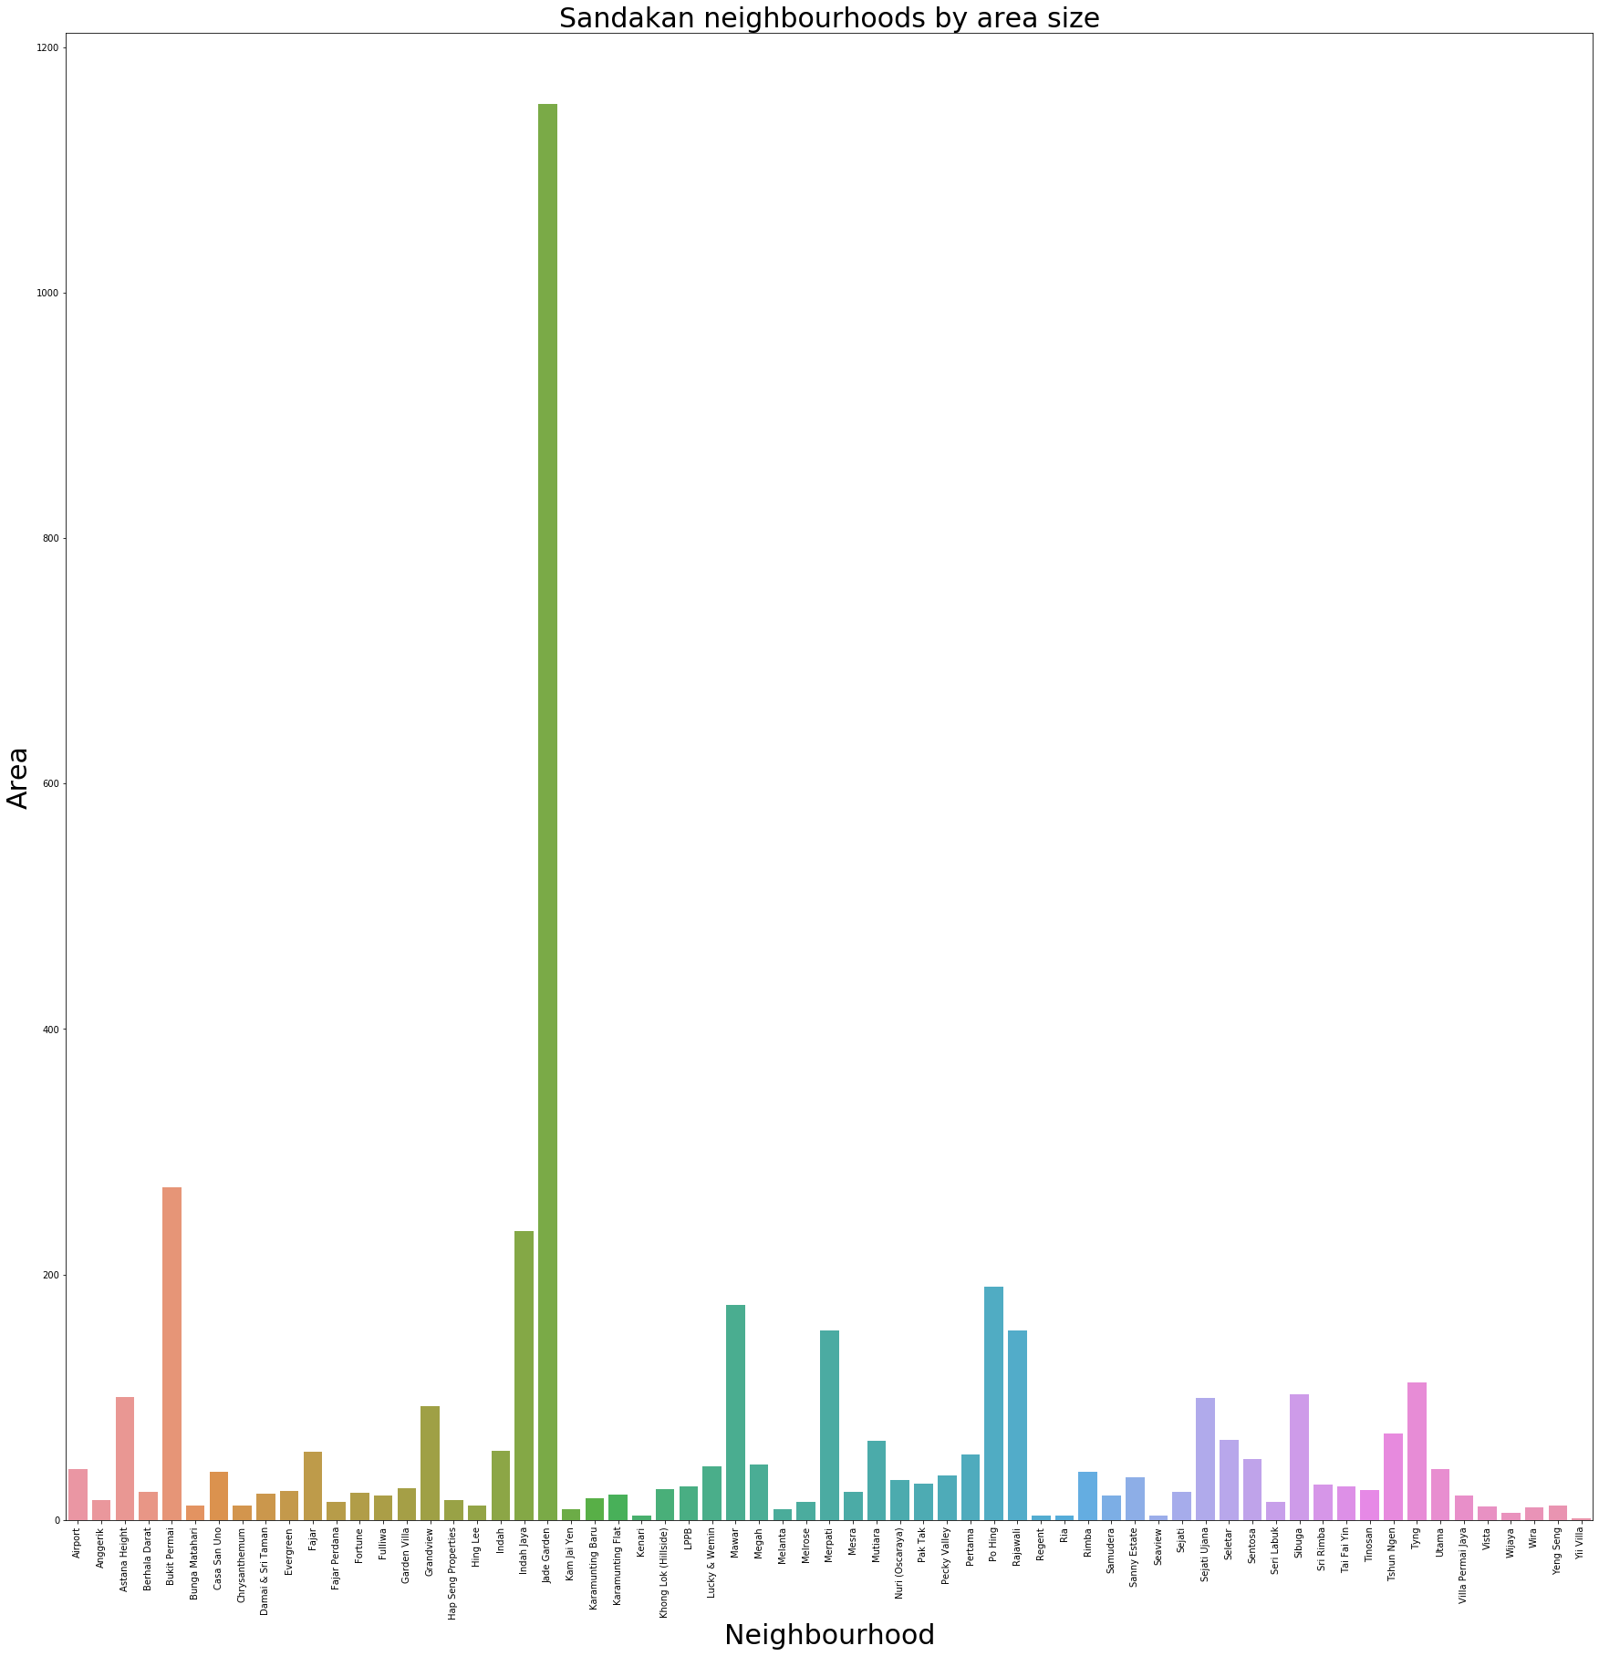
Sandakan neighbourhoods by area size

Slide 7
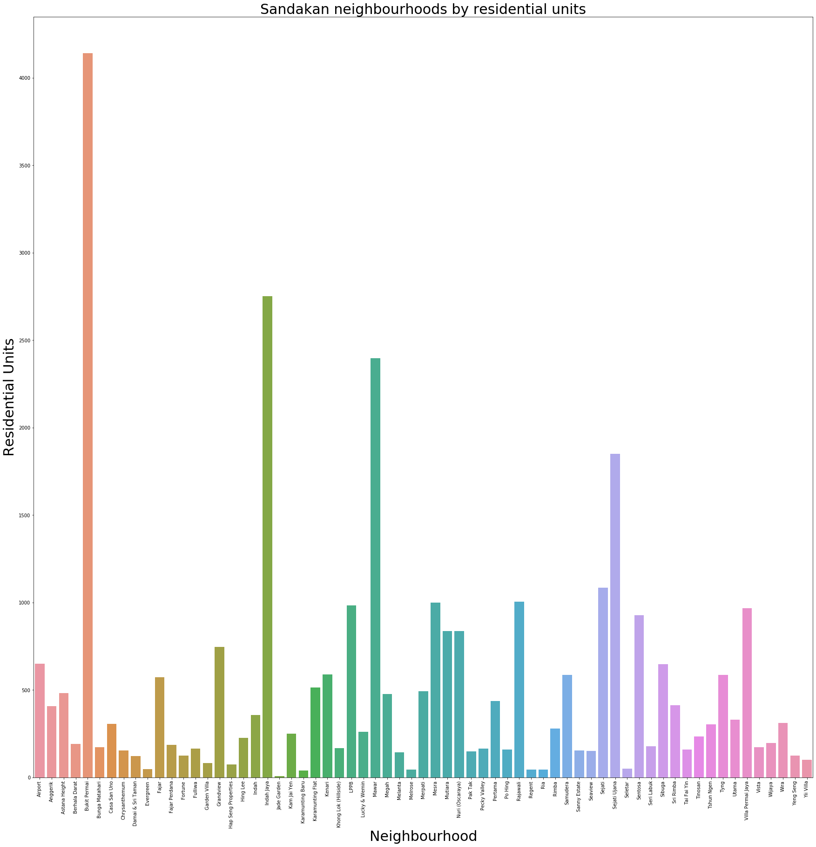
Sandakan neighbourhoods by residential units

Slide 8

Heatmap to illustrate Correlation

Slide 9
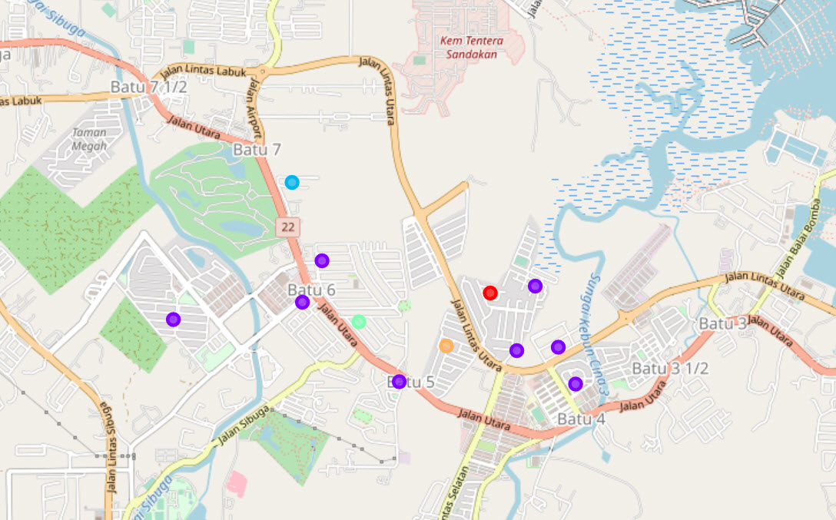
Results
Cluster 1: These neighbourhoods are concentrated
Cluster 4: Good potential in near future
Cluster 0,2 & 3: Stand-alone neighbourhoods

Slide 10
Discussion
Cluster 1 has highest number of neighbourhoods
Cluster 0, 2, 3 and 4 has one neighbourhood each

Slide 11
Recommendations
Cluster 1 is most desirable place to set up
businesses.
Cluster 4 has good business potential in future as new housing estates are nearby
The remaining clusters are not recommended due to stand-alone and lower population

Slide 12
Conclusion
The project has achieved its objective of classifying neighbourhoods with common venues each
Cluster 1 is identified as best location to set up new business
The project findings can assist business people to make decisions on business startups

Slide 13
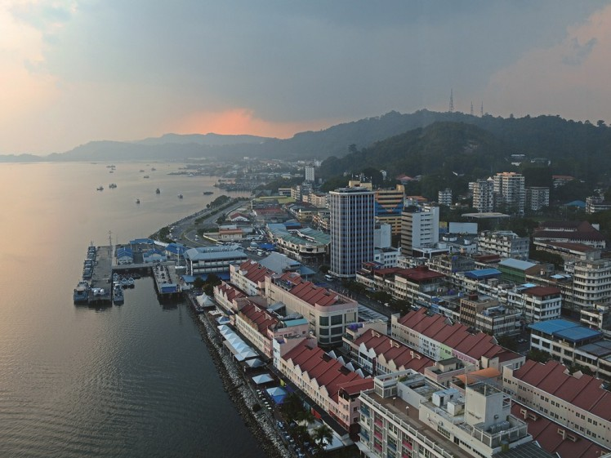
Thank you

